Slide 1





Dying in the Margins:
Palliative Care, Humanitarian Crises and the Intersection of Global and Local Health Systems
Rachel Yantzi
McMaster University
HEI Research Day March 14th, 2019
Notes:
Introduce self- RC
-discussing findings from a larger study Aid When There is “Nothing Left To Offer:” A Study of Ethics and Palliative Care in International Humanitarian Action
-today will be focusing on findings related to the influence of global and local health system on palliative care during humanitarian crises

Slide 2


Aid When There is “Nothing Left To Offer:”
A Study of Ethics and Palliative Care in International Humanitarian Action — 2016-2019
Funded by Elrha’s Research for Health in Humanitarian Crises (R2HC) Programme.
“The R2HC programme aims to improve health outcomes by strengthening the evidence base for public health interventions in humanitarian crises. The R2HC programme is funded equally by the Wellcome Trust and DFID, with Elrha overseeing the programme’s execution and management.”
Visit http://www.elrha.org/work/r2hc for more information about their funding programmes.
www.humanitarianhealthethics.net
Notes:
What are the moral obligations of international aid agencies?
What are practical realities of palliative care in humanitarian crises?

Slide 3
“If I’m treating this one, how is that going to affect those who are salvageable?”
-ND07
Experiences from humanitarian aid response indicate the need for palliative care
High mortality rates in some events, e.g. Ebola outbreak
Death is inevitable
Natural disaster, conflict, forced migration
Some will die as a result of the event, others were dying before
Response framework is rescue oriented, save as many lives as possible
Moral, epistemic, pressure from donors and funders to record high numbers of lives saved as measures of accountability
www.humanitarianhealthethics.net
Notes:
Humanitarian healthcare providers do their utmost to save lives.
This is a primary moral imperative.
While most humanitarian aid organizations recognizing the dual goals of saving lives and relieving suffering, responses tend to be focused on rescue.
The unescapable reality is that many patients will die due to injury or disease. Death is inevitable, in the context of disasters, conflict, forced migration, some will die as a result of the event and others were already living with life limiting illness.
-balancing sometimes competing priorities

Slide 4
12 International Humanitarian Aid Workers
Public Health Emergency: Ebola crisis in Guinea
Natural Disasters: Various Locations
Critical Interpretive Synthesis
International Survey
International Interviews
In-depth Case Studies
Protracted Refugee Situation: Rwanda
Acute Refugee Situation: Jordan
Acute Refugee Situation: Bangladesh
12 Humanitarian Policy Makers
www.humanitarianhealthethics.net
Notes:
Discussing results from in-depth case studies. Describe rest of study.

Slide 5
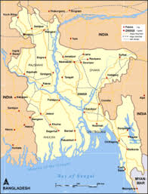
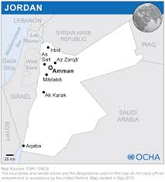
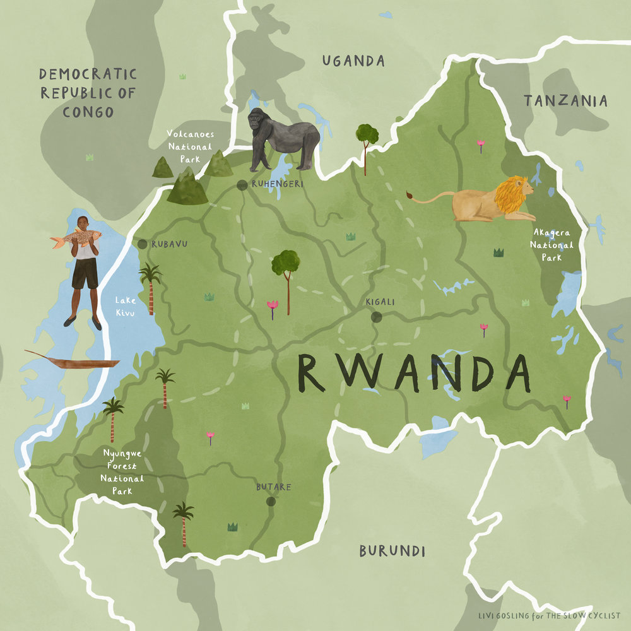
Case Study Recruitment
Jordan
Expression of our humanity: + providing palliative care, - labyrinth, long waits
Opiophobia
Impact of local and int’l policy
Rwanda
Respect our humanity
Needs within a limited healthcare system
Reliance on international aid
Guinea
2 survivors
6 local HCPs
2 local HCP/ survivors
1 religious leader
3 family members
2 international HCPs
Jordan
8 Refugees
5 Jordanian Nationals
2 local HCPs
1 international HCP
Rwanda
10 refugees in two camps
6 local HCPs
1 agency representative
Bangladesh
1 local palliative care physician
2 lay health workers
Natural Disasters
Nepal, India, Chad, Haiti, Philippines
11 international HCPs
6 local HCPs
Notes:
Jordanian refugees: cancer, lung fibrosis, renal disease, traumatic injury during the war, multiple sclerosis, heart failure. Some refugees from a camp, others in the community
Rwanda refugees: Leukemia, Breast cancer, mitral stenosis, other cancers, blast injury,
Interviews are in the process of being analyzed using Nvivo using Sally Thorne’s “Interpretive Description methodology”, in order to produce case specific reports as well as a paper describing overarching themes that emerged from the study. Today I will focus on themes that have emerged from the overall study focusing on the interaction between local and global health systems, as it relates to palliative care

Slide 6
Health system limitations are amplified in humanitarian crises
Curative care capacity constraints disproportionately impact refugees and others made vulnerable by their social position; they are often the first to face the health system’s limitation
Curative care or screening options are already limited for local nationals; refugees, marginalized, poorer people or those unfamiliar with navigating the local culture, let alone a health system, are less likely to access timely care, resulting in premature palliative needs
Palliative care should never be considered a replacement for the need to continually improve the local health system
www.humanitarianhealthethics.net
Notes:
Humanitarian crises stress already fragile health systems, and limitations are amplified
-limited access to screening and early treatment resulted in individuals with preventable but advanced disease
-people forced to migrate no understanding local system, late diagnosis, delay because system is inefficient, bureaucratic hurdles, or unfamiliar with how to navigate
-some participants, particularly HCPs, feared that offering palliative care will be seen as an alternative to quality, early treatment

Slide 7
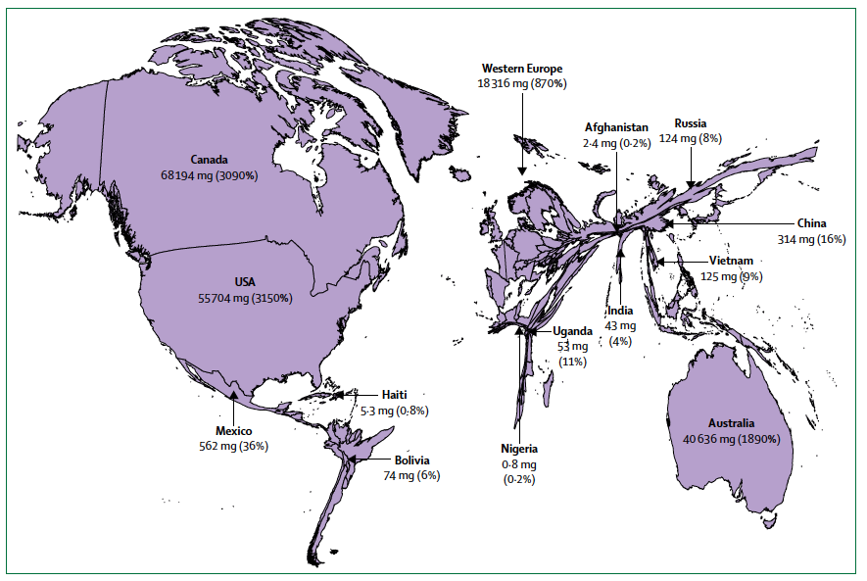
Inequitable access to opioids
www.humanitarianhealthethics.net
Source: International Narcotics Control Board and WHO Global Health Estimates, 2015.
Notes:
-access to opioids was nearly synonymous with palliative care
-palliative care as much broader than just pain relief,
-“necessary but insufficient” to provide palliative care.
-baseline inadequate access to opioids.
-Humanitarian crises exacerbate this problem in a number of ways
-sudden influx of patients during a conflict or natural disaster can overwhelm limited stocks
-national opioid regulations can prevent rapid influx of needed opioids
-refugees and internally displaced individuals may be cut off from banks or other sources of income which they would normally use to buy pain medications.
-fears related to opioids hastening death or addiction

Slide 8
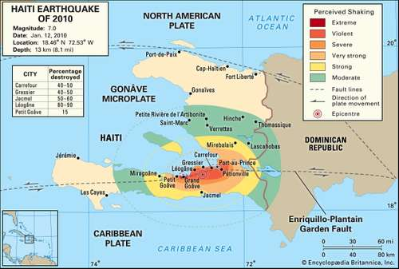
Overwhelmed health systems
Haiti wasn’t prepared for an earthquake. And had no contingency plan for how to approach this. So much so that the whole country get paralyzed. The president puts his hand up - and waiting to see who was gonna come and help him and was really ready to have somebody to become president instead of him (Local HCP-ND-07)
https://www.britannica.com/event/Haiti-earthquake-of-2010
Yeah, mainly it’s always about the same thing. Why we have to intervene in a country. Why they don’t need to intervene in ours. If we have a natural disaster here as a country we will be able to intervene (International HCP-ND-01)
www.humanitarianhealthethics.net
Notes:
Healthcare systems with little reserve capacity rely more heavily on outside aid to assist following disasters (eg. tsunami in India vs. Haiti), international response focused on psycho-social support
Weak health care systems don’t always have reserve capacity to plan for disasters; particularly care of dying during a disaster sometimes seen as beyond their capacity when barely able to save lives
Read quotes

Slide 9
Barriers to Palliative Care Access during Disasters
I think it's going to be a space related issue, not necessarily a staff related issue. But more a space related issue. Because if I think after the earthquake all hospitals in the country were overcrowded, all of them. So even though you wanted to put in place palliative care you wouldn't be able to do it because all structures were overcrowded and at some point you were obliged to to put people outside on the streets so it's going to be a space related issue. (Local HCP in Haiti-ND-11)
But she was not able to go to the capital city every three or four weeks because of financial and, because of financial reasons. And she used to visit to the hospital and there I tried to drain her fluid and make her feel comfortable… Her house was demolished by the earthquake and she was displaced from her house, living in a temporary center. Nearby the hospital and she had ascites and liver failure. So she used to visit the hospital often (Local HCP in Nepal -ND-17)
www.humanitarianhealthethics.net
Notes:
During natural disasters, Infrastructure damage impacts both the physical health system and individual patients
-massive destruction of health facilities plus a massive influx of patients may limit space forcing staff to make difficult triage choices, limits ability to offer any palliative care let alone dignified/quiet/private space
-Vulnerable individuals with chronic/life limiting health needs may not have resources to overcome barriers to accessing care (due to financial/mobility barriers) –mobility challenges all that much more amplified when roads are destroyed
-crowded, inadequate temporary housing can exacerbate illnesses like COPD
-cut off from maintenance medications for congestive heart failure leading to premature death

Slide 10
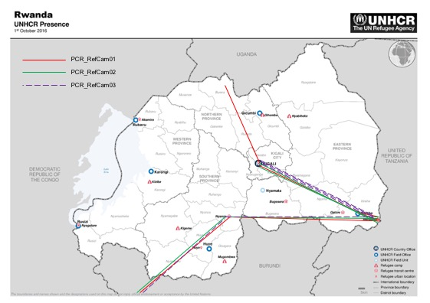

Refugee specific barriers:
Labyrinthine care pathways and long waits
Being unsettled in health status, social location, & physical place
Removed from comforts
www.humanitarianhealthethics.net
Notes:
Labyrinthine care pathways:
Complexity of travelling when feeling terrible, nauseous, etc.
-requirement to travel from camp in south-east, to capital in Kigali for approvals, then on to cancer center in north for treatment, often sleep outside in hospital courtyard the night before treatments
NUTRITION: how to eat variety of foods when family starving?
Being unsettled: ESPECIALLY: fear of dying away from home, fear of leaving family members behind in a foreign country, wanted to connect with lost family members

Slide 11
Recommendations from participants:
“of course, currently I’m stronger since I went to see – I know that when I was getting treatment there are so many other people there, so you know when they tell you this you feel like you aren’t just the only one who is having that kind of problem…when you see other people get it, it increases your morale” - PCR_03
Interdisciplinary care
Palliative care department
Essential medicines
Infrastructure adjustments to provide privacy and comfort to the dying
  Electricity
  Private toilette facilities
Peer support & trained community health workers
Dedicated – direct care: bypassing the triage stations in the camp health centres
Holistic, interdisciplinary care: palliative care integrated in the different health disciplines represented in the camp health centre.
www.humanitarianhealthethics.net
Notes:
-the need for interdisciplinary care to address variety of needs
-dedicated departments so they don’t have to wait in triage lines
-specific medications needed to relieve symptoms
-access to transportation
-small details you wouldn’t necessarily think of such as a fan, electricity, clean toilets
-importance of peer support and volunteer caregivers to just accompany dying patients

Slide 12
Two senses to “aid when there is ‘nothing left to offer’”
Clinical care… and resource scarcity.
MACRO
MESO
MICRO
Macro
Global geopolitical & economic systems
State ideologies
Historical legacies
Meso
Health system
Public health education
Micro
Family contact & responsibilities
Burial practices and bereavement
Stigma, taboos
Long
Time
Short
…indeed there remains much that can be offered.
www.humanitarianhealthethics.net
Notes:
What do you do when cure is no longer an option?
Other sense: what can you do when there is nothing left to offer due to resource scarcity. We learned from participants that there are still low cost interventions that exist
One of the main moral argument against the application of PC is said to be a choice between curative or palliative care, a dichotomy.
-people are dying potentially curable illness, what is the role of palliative care.?
-Our research shows that there are many ways in which the two happen simultaneously.
We have been hearing stories for months about how it is being done, even if not recognized formally, not budgeted as a line item, or as part of a targeted donor campaign.
We need to be working at all levels to address global and local health system barriers to palliative care. Palliative care was recognized as an essential component of holistic, comprehensive humanitarian healthcare, and should never act as a substitute to health system improvements for curative care.

Slide 13
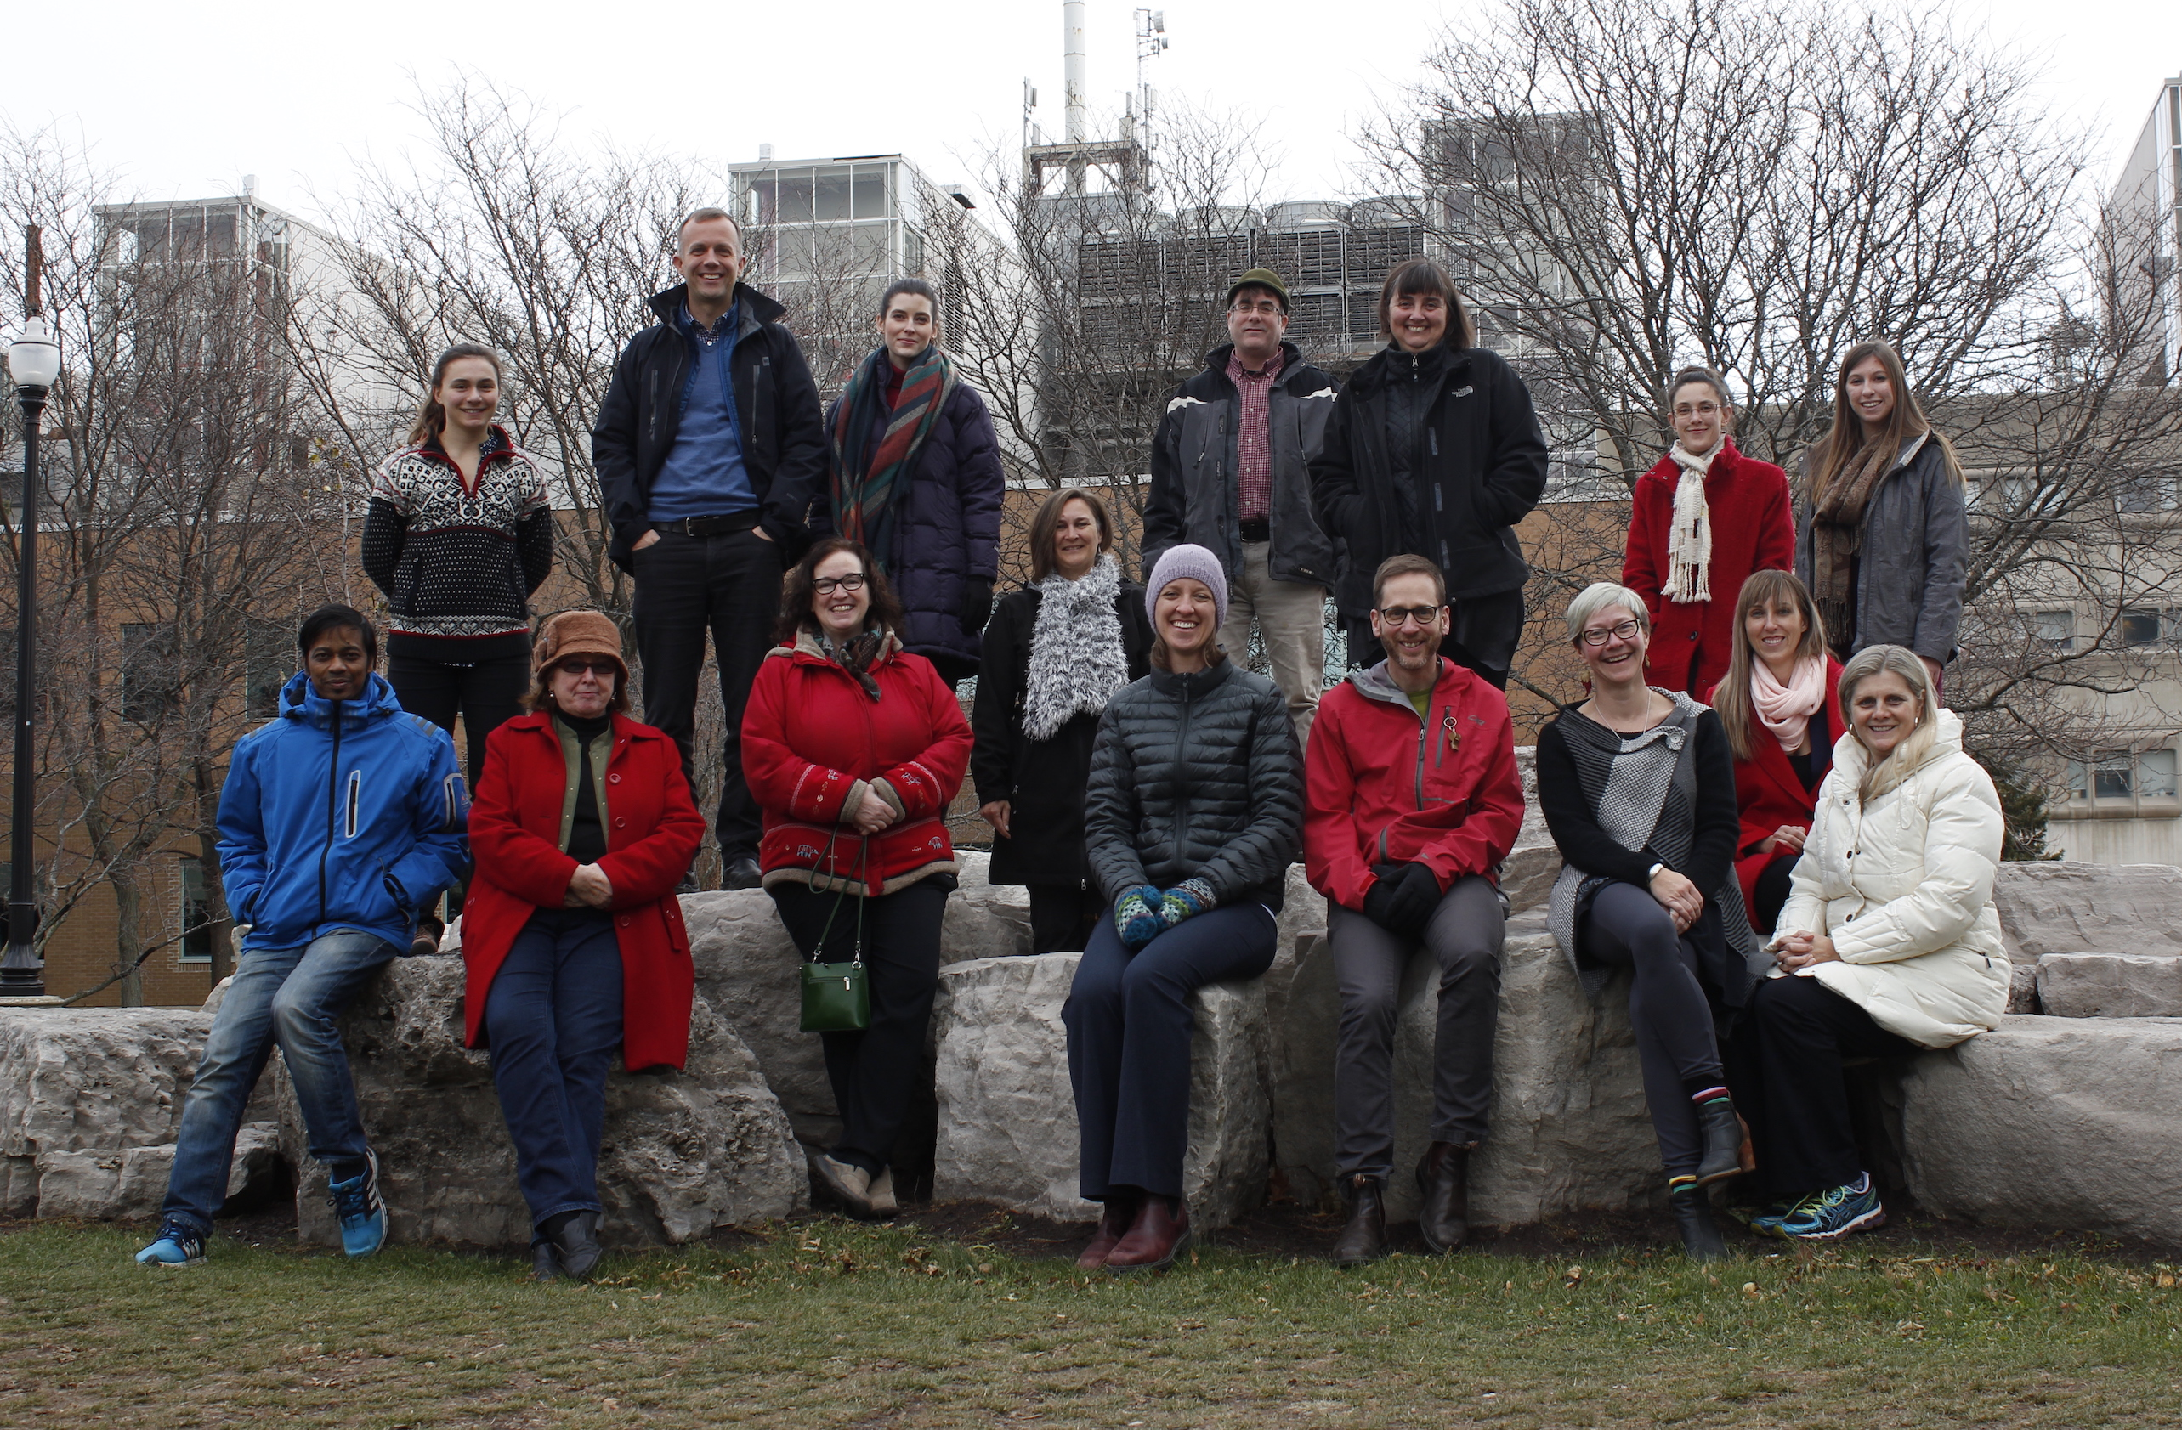
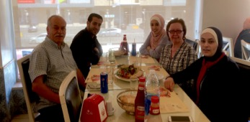
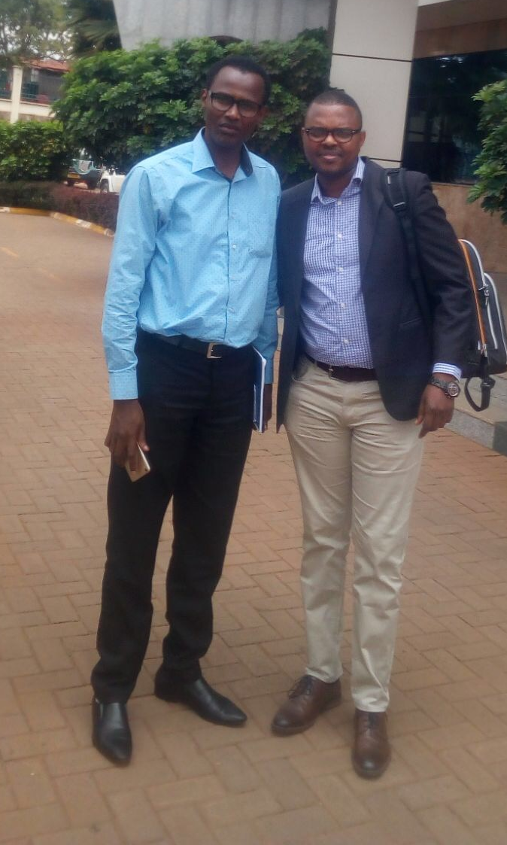
Thank you!
We are ever so grateful to the participants, particularly those living with serious health challenges, for taking the time to talk with us. The narratives shared were moving and thought-provoking, invaluable and crucial.
The HHE research group for the full study:
Co-PIs: Lisa Schwartz & Matthew Hunt
Alphabetically: Ibraheem Abu-Siam, Oumou Bah Sow, Carrie Bernard, Kevin Bezanson, Ani Chénier, Philip Cotton, Sonya de Laat, Pathé Diallo, Laurie Elit, Leigh-Anne Gillespie, Wejdan Khater, Sékou Kouyaté, Emmanuel Musoni, Elysée Nouvet, Lynda Redwood-Campbell, Ross Upshur, Olive Wahoush, Rachel Yantzi, Laila Zeheya.
www.humanitarianhealthethics.net

